Slide 1
DCSE DHABBA
Uzair sultan (17pwcse1509)
Imad rashid (17pwcse1541)
Mohsin khan (17pwcse1525)

Slide 2
INTRODUCTION:
This Restaurant Bill Calculator project is written in Python. The project file contains a python script.
This is a simple GUI based application which is very easy to understand and use. It uses Tkinter module for the GUI.
The design is so simple that the user won’t find any difficulties while working on it. In order to run the project, you must have installed Python and on your PC
Talking about the application, the user just has to select among the food and drinks items, enter the quantity and click on the total button to view the total price. This simple application also displays the total prices of each item without any tax and extra charges.

Slide 3
Graphics:
All graphic features of this application are designed by using the tkinter GUI module of python.

Slide 4
WORKING:
After running the program, the user has to login by providing the username and pin number. Then the system asks whether to continue to the application or change the price of foods. The user can view the total receipt of their items which displays receipt number and number of their food/drinks items with the total amount. Here, the total bill of the customer includes tax and service charges too. In order to change the price of foods, the user just has to enter the price and click on the update button, it’ll change that particular item’s price.

Slide 5
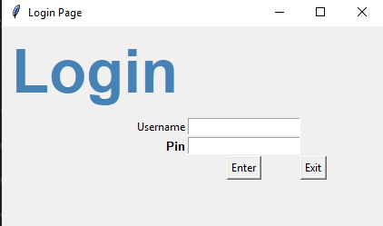
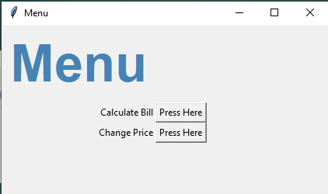
LOGIN AND MENU WINDOW:

Slide 6
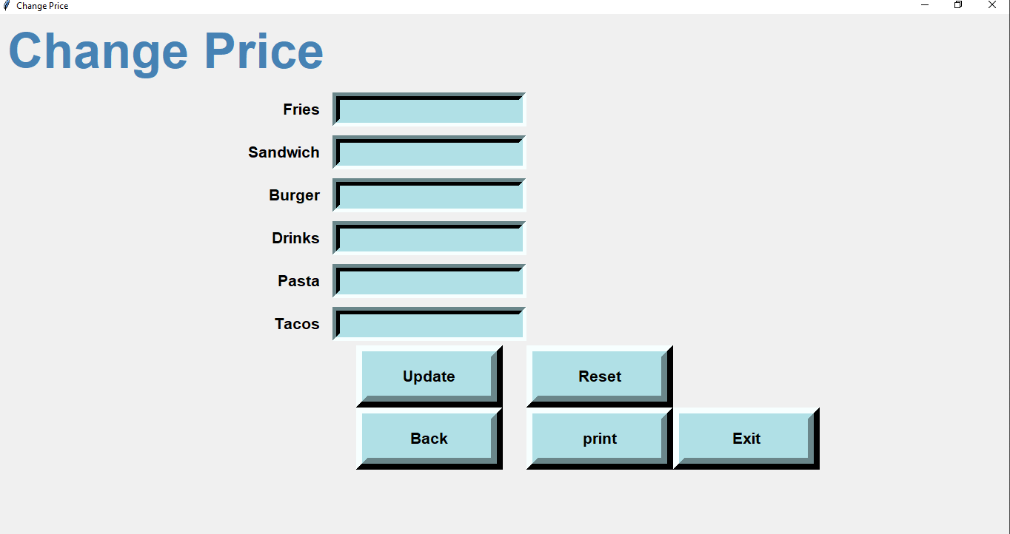
PRICE CHANGE WINDOW:

Slide 7
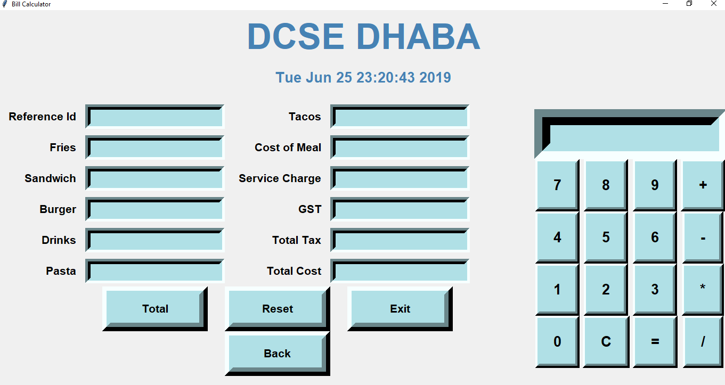
BILL WINDOW:

Slide 8
NEED:
Now a day in our daily life restaurant business is everywhere and it is very difficult to calculate the bills all day long for your customers. It is hectic and it has a huge chance of error in it which may lead to loss in your business.

Slide 9
Thanks it.
Thank You.

